Slide 1

Visvesvaraya Technological University “Jnana Sangama”, Belagavi – 590018 Department of Computer Science and Engineering
Master of Computer Application Project Presentation
on
“TrackFit AI- AI Based Workout Monitoring & Lifestyle Analyzer”
By
Mohammed Ayaz Gour
USN:2VX23MC087
Under Guidance
of
Dr.Shivgonda M Patil
Asst Prof Department of CSE(MCA)

Slide 2
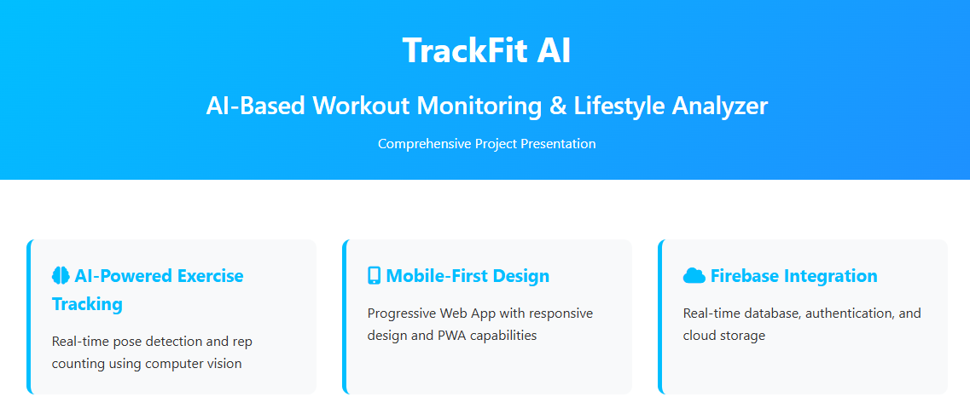



Slide 3

Data Collection
Real-time Video Stream
Webcam integration for live exercise tracking
Frame-by-frame processing at 30 FPS
Base64 image encoding for API transmission
Automatic camera permission handling
User Data Collection
User registration and authentication
Exercise history and progress tracking
Workout session data storage
Performance metrics and analytics
Exercise Database
Pre-defined exercise categories
Difficulty level classification
Exercise instructions and demonstrations
Product and trainer information

Slide 4
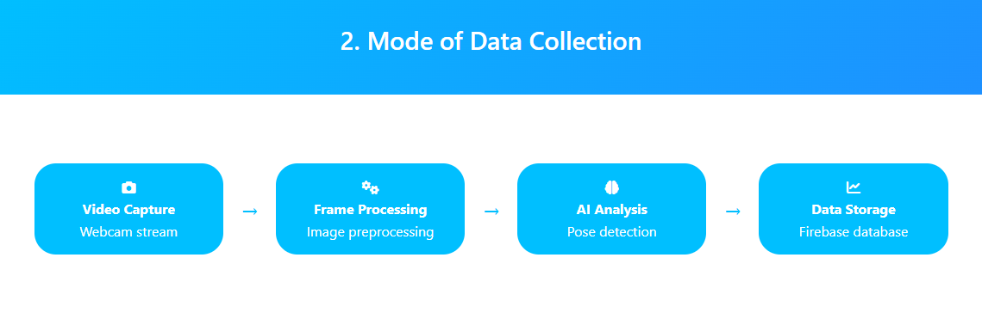
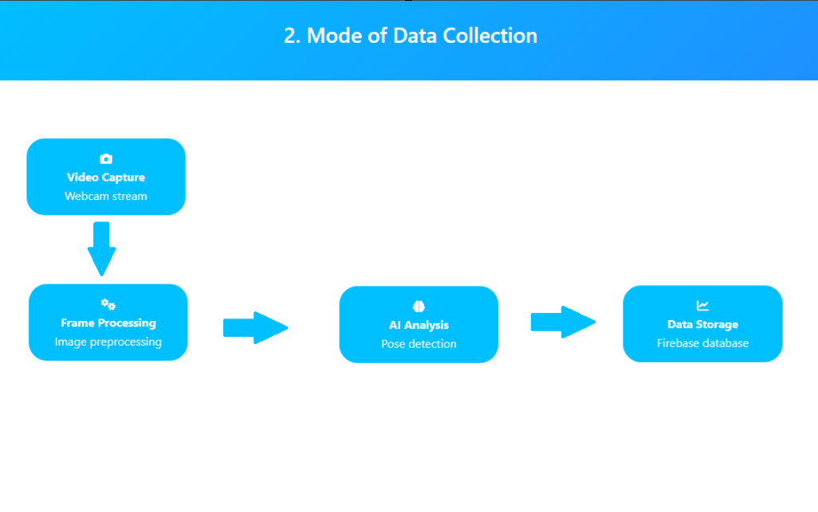

Slide 5
Proposing Model Selection
MediaPipe Pose
Google's real-time pose detection model
33 body landmarks tracking
95% accuracy for pose detection
Cross-platform support
Computer Vision
OpenCV for image processing
30 FPS processing capability
640x480 resolution optimization
Real-time frame analysis
Mathematical Models
NumPy for angle calculations
Trigonometric computations
Precision to 0.1 degrees
3D coordinate analysis

Slide 6
Technological Stack
Backend Technologies
Flask Web framework
Flask-CORS Cross-origin support
OpenCV - Computer vision
MediaPipe Pose detection
NumPy -Mathematical operations
Pillow Image processing Frontend Technologies
HTML5 - Semantic markup
CSS3 - Responsive design
JavaScript ES6+ - Dynamic interactions
Firebase - Real-time database
Font Awesome - Icons
Google Fonts - Typography

Slide 7
Algorithm Selection and Customization
Pose Detection Algorithm
MediaPipe Pose with 33 landmarks
Real-time tracking with 0.5 confidence threshold
3D coordinate extraction (x, y, z)
Automatic pose estimation
Angle Calculation Algorithm
Trigonometric angle calculation
Three-point angle measurement
Precision to 0.1 degrees
Real-time angle update
Rep Counting Algorithm
State machine for exercise stages
Threshold-based rep detection
Exercise-specific angle thresholds
Automatic counter reset
Exercise-Specific Algorithms
Biceps Curls: Down >160°, Up <30° (95% accuracy)
Squats: Up >160°, Down <110° (90% accuracy)
Push-ups: Up >160°, Down <90° (85% accuracy)
Real-time form analysis

Slide 8
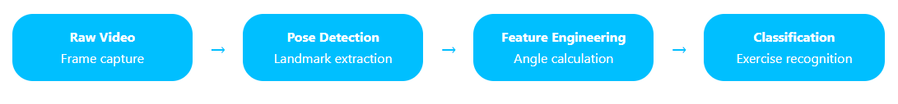
Feature Identification and Transformation
Landmark Features
33 body pose landmarks
3D coordinate extraction (x, y, z)
Confidence scores for each landmark
Real-time landmark tracking
Derived Features
Exercise type classification
Rep count and duration
Form quality assessment
Performance metrics
Feature Transformation
Coordinate normalization
Angle calculation from landmarks
State classification (up/down)
Rep counting logic

Slide 9
Model Training and Optimization
Model Optimization
Confidence threshold tuning (0.5)
Frame rate optimization (30 FPS)
Image quality reduction for speed
Memory-efficient processing
Performance Metrics
Real-time processing capability
Low latency response (<100ms)
High accuracy across exercises
Robust pose detection
Deployment Optimization
Flask API optimization
CORS configuration
Error handling and recovery
Scalable architecture

Slide 10
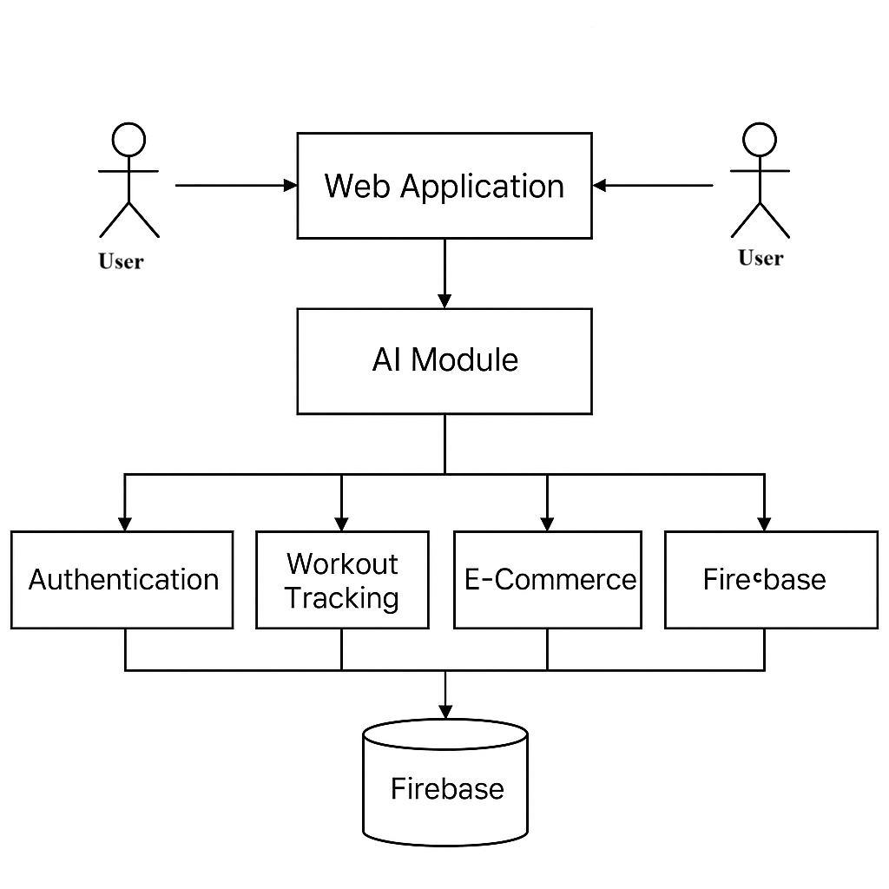
System Design

Slide 11
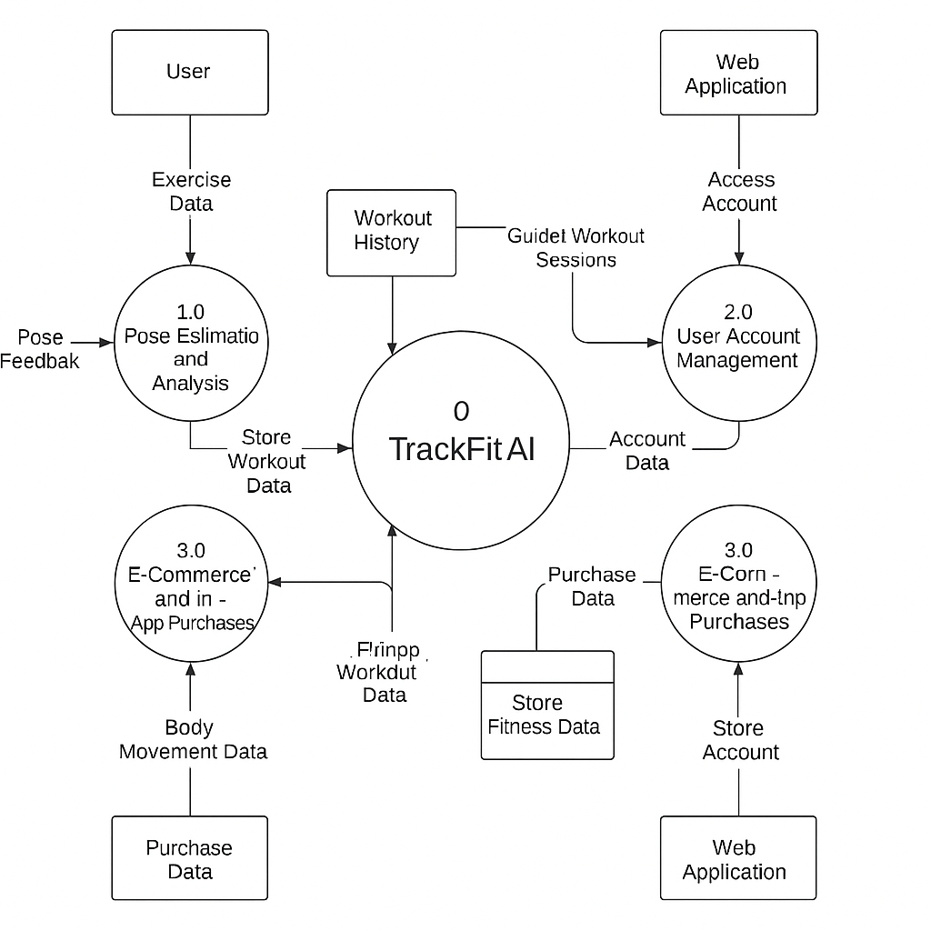
Zero level DFD

Slide 12
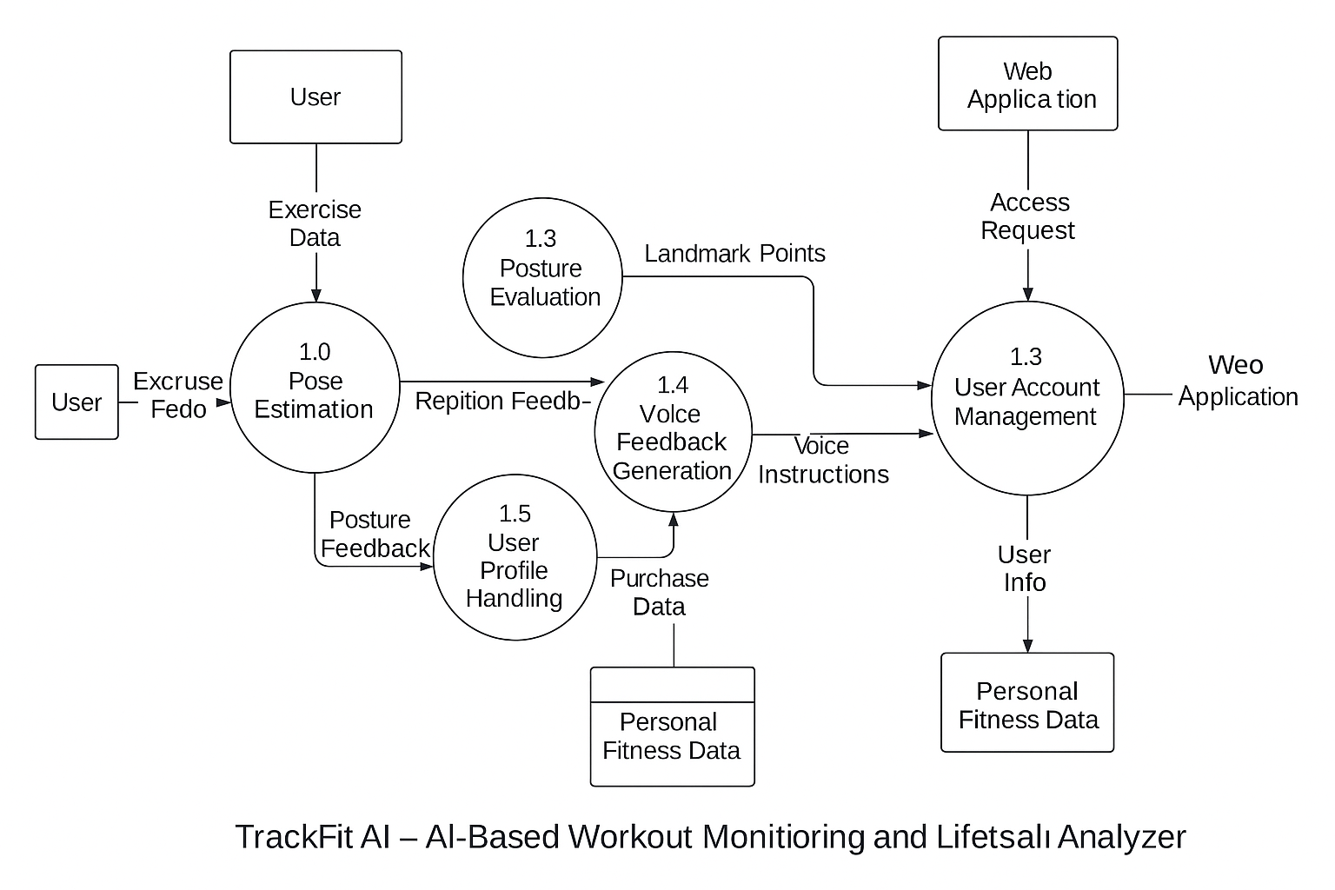
First level DFD

Slide 13
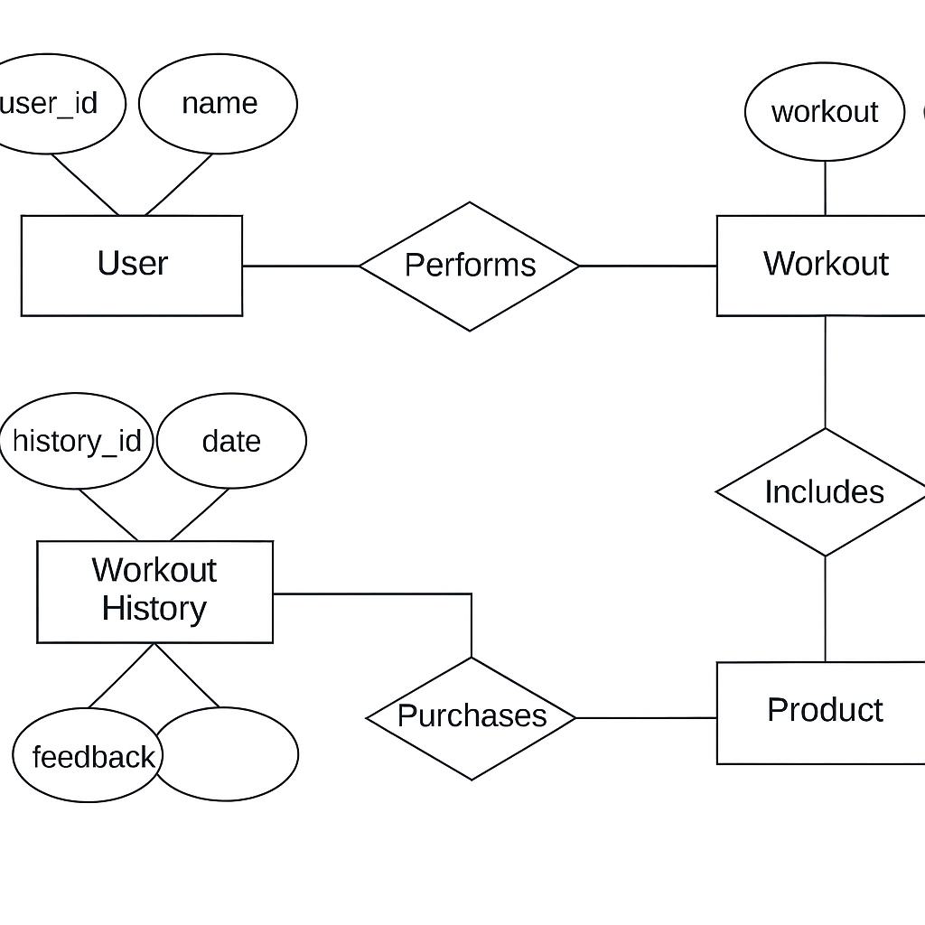
ER Diagram

Slide 14
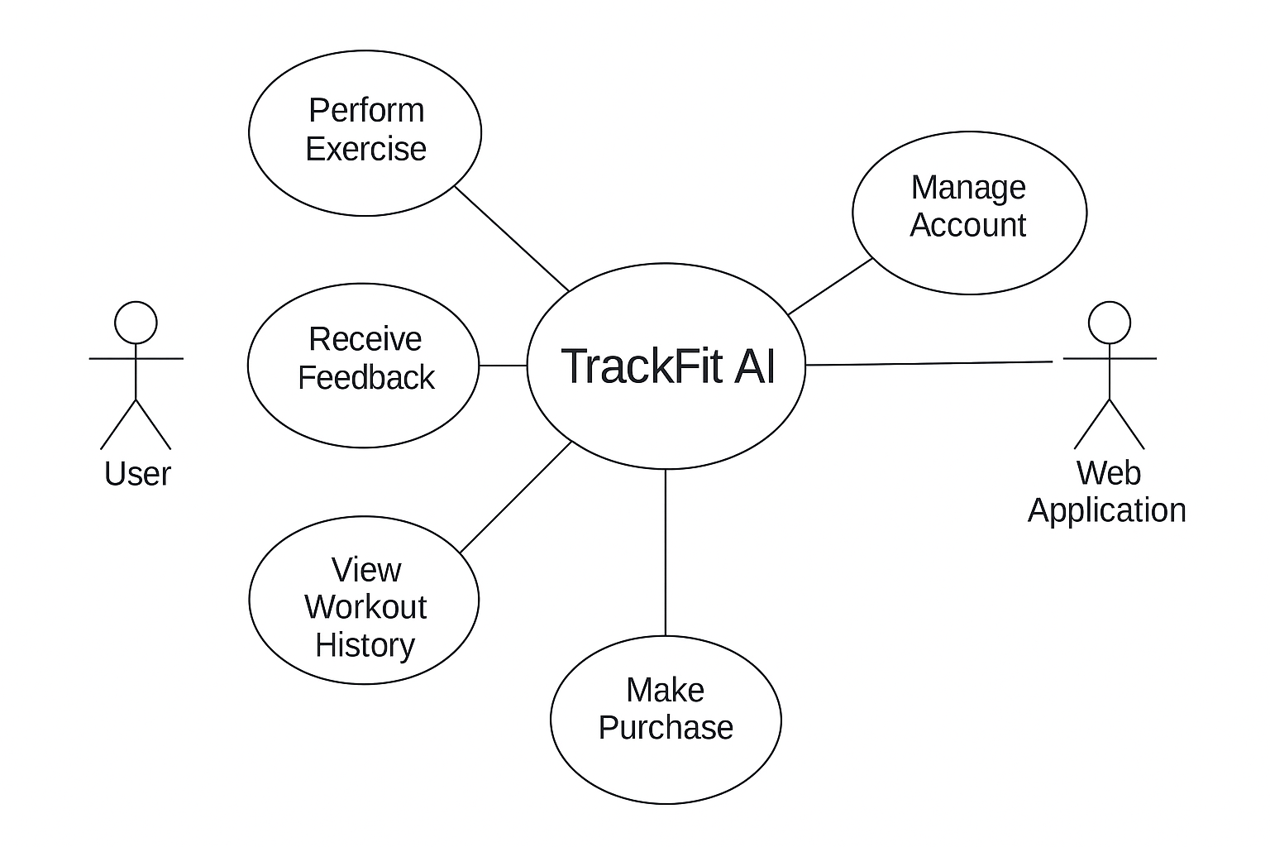
Use Case Diagram

Slide 15
UI Design
Trackfit AI

